Slide 1

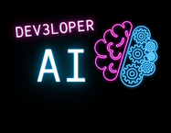


From Concept to Code: Leveraging LLMs for Agile Excellence
Revolutionizing software development with AI from concept to code.
Justin Beall
/justin-beall
Notes:
**Summary:**
This introductory slide welcomes the audience and sets the stage for exploring AI's role in modern agile development.
**Speaker Notes:**
- Greet the audience and introduce yourself briefly.
- Invite everyone to settle in and prepare for an engaging session.
- Mention the presentation's title and its intriguing promise of transforming development practices with AI.

Slide 2

Session Objectives
What We'll Cover Today
- Integration of LLMs in agile processes
- Enhancements AI offers to XP practices
- Strategic frameworks: VISION, ADAPT, LEAP
Justin Beall
/justin-beall
Notes:
**Summary:**
The slide sets clear objectives for the session, outlining what attendees will learn about integrating LLMs into agile processes and XP practices.
**Speaker Notes:**
- **Objective Context:** Start by saying, "This slide frames our objectives today, guiding us through the session's key topics."
- **Integration of LLMs:** Highlight how the session will showcase integrating LLMs like ChatGPT into agile processes for enhanced productivity and innovation.
- **Enhancements in XP Practices:** Outline how AI can revolutionize Extreme Programming (XP) by improving pair programming, test-driven development, and continuous integration practices.
- **Frameworks Highlighted:** Briefly explain the strategic frameworks we’ll cover—VISION, ADAPT, LEAP—to provide structure and clarity on applying AI insights at strategic, tactical, and operational levels.
- **Transition:** Conclude with, "Let’s explore these objectives in more detail throughout our presentation.

Slide 3


About Me
Experience at the
Intersection of AI and Agile
- Staff Engineer at Artium,
founder of Dev3loper.ai
- 18+ years in software development
- Passionate about AI and
agile methodologies (XP)
Justin Beall
/justin-beall
Notes:
**Summary:**
This slide provides a personal introduction, highlighting your experience and passion for AI and agile methodologies.
**Speaker Notes:**
- **Introduction:** Briefly share your professional background, emphasizing your dual role as a Staff Engineer at Artium and founder of Dev3loper.ai.
- **Experience:** Mention your 18+ years in software development and your journey through various industries, focusing on AI and agile practices.
- **Passion and Vision:** Express your enthusiasm for AI's potential to revolutionize software development and the importance of continuous learning and innovation.
- **Transition:** Set the stage for the presentation by connecting your experiences to the themes you'll explore, like AI's role in transformation and innovation within agile frameworks.

Slide 4

Setting the Stage
Challenges in Modern
Software Development
- Slow development cycles
- Misalignment with market demands
- Staff/resource inefficiencies
Justin Beall
/justin-beall
Notes:
**Summary:**
This slide outlines the primary challenges in modern software development, emphasizing the need for AI to address these issues effectively.
**Speaker Notes:**
- **Introduction of Challenges:** "This slide outlines key challenges we face in today's software development landscape."
- **Slow Development Cycles:** Illustrate how traditional processes often lead to extended timelines and how these can stifle innovation.
- **Misalignment with Market Demands:** Discuss real-world examples where product launches failed due to a lack of alignment with user expectations and market trends.
- **Staff/Resource Inefficiencies:** Highlight inefficiencies in resource allocation and team dynamics that impede progress.
- **Need for AI Solutions:** Lead into the next part of your presentation by asserting how AI presents solutions to these challenges.

Slide 5

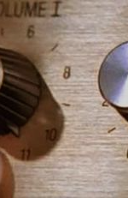
Role of AI and XP
Maximizing XP with AI
- AI boosts efficiency and innovation
- XP: If it's good, turn the dial up to 11
- AI enhances XP's continuous feedback loops
Justin Beall
/justin-beall
Notes:
**Summary:**
This slide explores how AI amplifies Extreme Programming (XP) by enhancing its continuous feedback and innovation cycle.
**Speaker Notes:**
- **Amplification of Practices:** "This slide defines how AI leverages the strengths of XP, essentially turning up the dial by enhancing existing practices."
- **Boost in Efficiency:** Explain how AI tools like ChatGPT and GitHub Copilot can accelerate coding tasks and facilitate rapid feedback, aligning with XP’s principle of fast iteration.
- **Continuous Feedback Loops:** Highlight AI's role in enriching the XP feedback loop, providing real-time insights and actionable intelligence.
- **Transformation Synchronicity:** Conclude with AI's ability to synchronize transformation across processes, uniting teams through enhanced collaboration and shared intelligence.

Slide 6

AI-Powered
Product Development
From User Story to Deployment
Justin Beall
/justin-beall
Notes:
**Summary:**
This slide introduces a video segment highlighting AI's impact on software development through vivid, real-world examples.
**Speaker Notes:**
- **Purpose of the Video:** "This clip showcases AI's transformative role in real-world software development scenarios."
- **Key Themes to Watch:** Ask the audience to focus on how AI enhances efficiency across coding, testing, and deployment phases.
- **Opportunity for Demos:** Mention, "While time limits us from doing live demos today, I'm eager to explore these with you. Feel free to connect with me on LinkedIn or here at the conference if you want more hands-on examples."

Slide 7
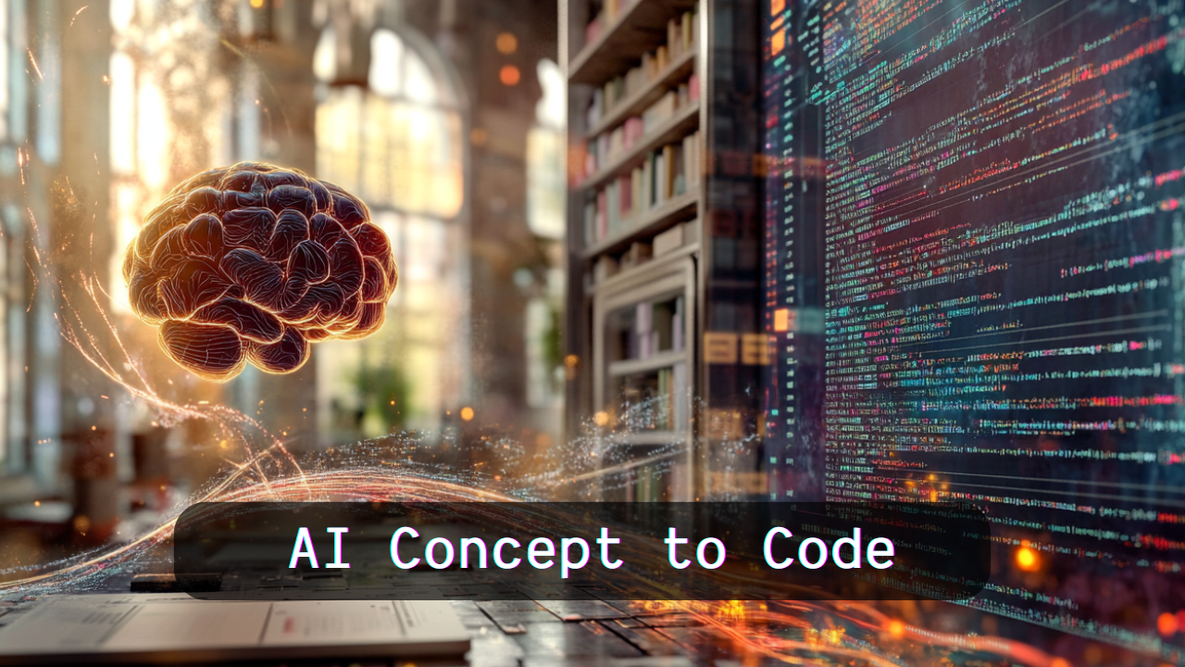
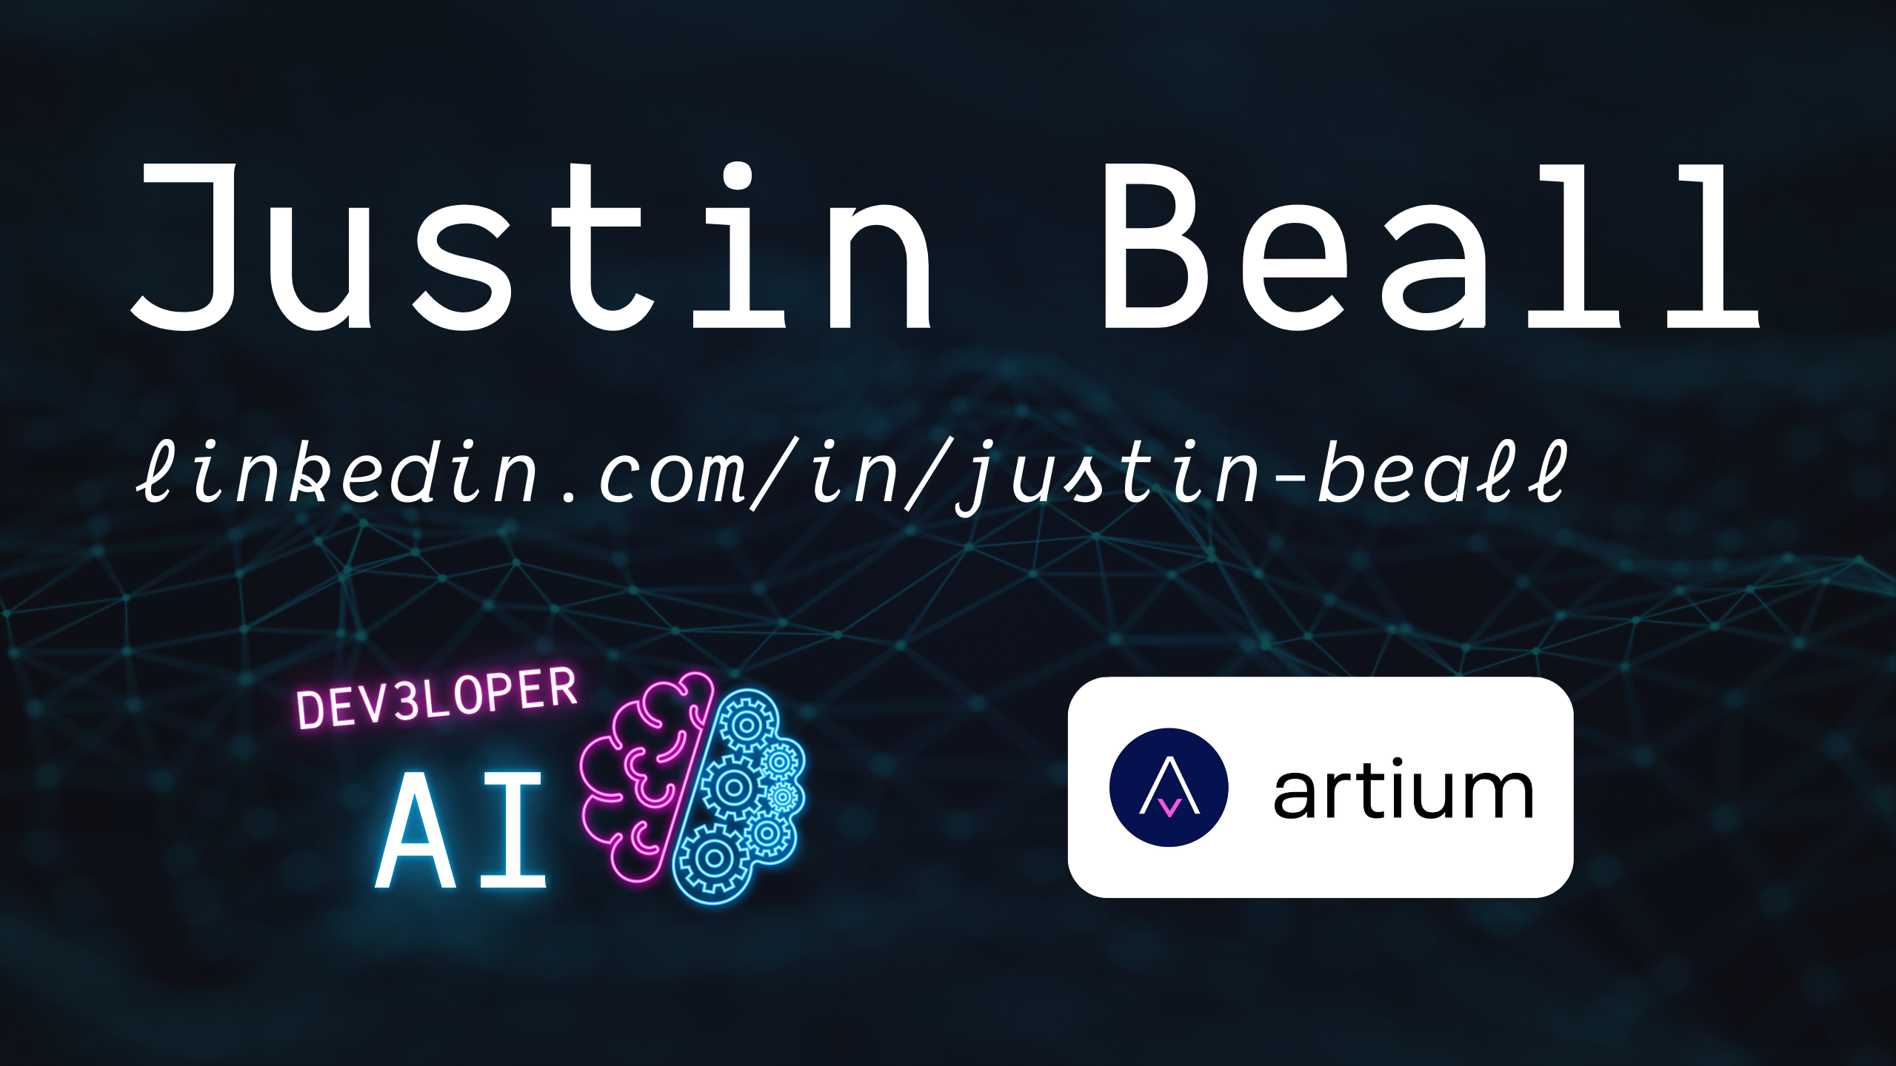
https://tinyurl.com/ai-concept-to-code
Notes:
**Summary:**
This slide presents a video exemplifying the practical application and benefits of integrating AI into agile development environments.
**NOTE**: Video is 1:35 seconds long – potential for a live demo
**Speaker Notes:**
- **Introduction to Video Purpose:** "These clips illustrate how AI technologies are integrated into real-world agile workflows to enhance efficiency and innovation."
- **Focus Areas:** Encourage the audience to look for insights on AI's role in automating tasks and augmenting decision-making.
- **Engagement Note:** Suggest, "If anyone is interested in exploring these implementations live and learning more, feel free to contact me during the conference or connect on LinkedIn."

Slide 8
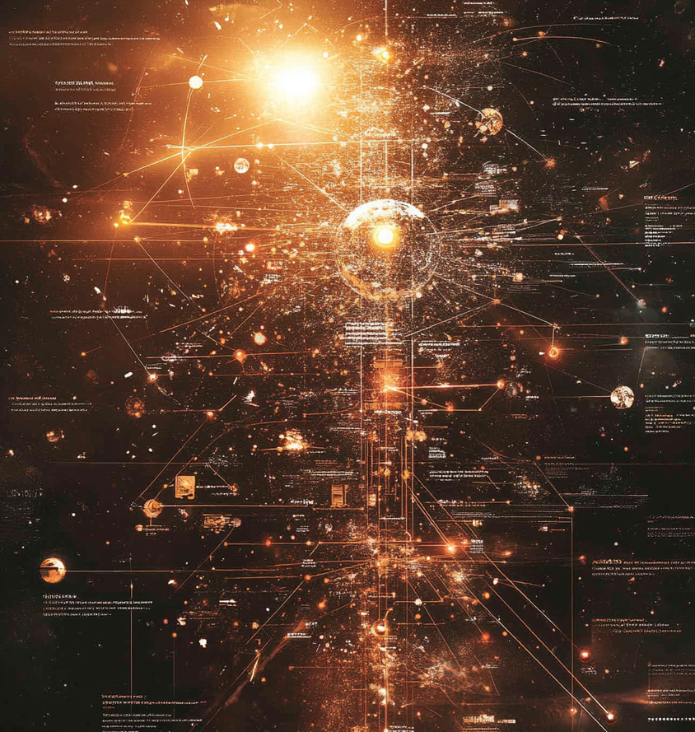
Core Principles
of AI-XP
Embracing the Core Values
- Continuous Feedback & Improvement
- Customer-Centric Collaboration
- Courage to Innovate
Justin Beall
/justin-beall
Notes:
**Summary:**
This slide introduces the fundamental principles of AI-XP: continuous feedback, customer-centric collaboration, and innovative courage.
**Speaker Notes:**
- **Introduction to Core Values:** "We're now exploring AI-XP's core principles, which amplify the values of Extreme Programming with AI-driven enhancements."
- **Continuous Feedback:** Explain how continuous feedback is bolstered through AI's real-time data analytics, driving improvement.
- **Customer-Centric Approach:** Emphasize the role of AI in deepening customer collaboration by rapidly translating feedback into actionable insights.
- **Courage to Innovate:** Highlight the importance of courage in exploring AI's 'jagged frontier,' echoing the dynamic synergy of human and machine intelligence.
- **Call to Action:** Encourage a mindset that embraces innovation and adaptability in the face of technological advances.
- **XP Core Values:**
- **Communication:** Stress the importance of clear and open dialogue, enhanced by AI's ability to provide timely insights and data-driven decisions.
- **Simplicity:** Emphasize creating simple solutions over complex ones, with AI helping to identify the most efficient paths forward.
- **Feedback:** Leverage AI for continuous feedback, leading to rapid iteration and improvement.
- **Courage:** Encourage the boldness to refactor and innovate, supported by AI's capacity to validate and refine new approaches.
- **Respect:** Maintain mutual respect within teams, as AI tools augment human effort without replacing the need for respect in collaboration.
- **XP Principles Embellished by AI:**
- **Rapid Iterations:** AI accelerates testing and coding cycles.
- **Customer Focus:** AI helps align development closely with customer needs and feedback.
- **Sustainable Pace:** Ensure that AI tools are used to support a manageable and balanced work pace.
- **Encourage Attendees to Embrace These Values:** Reinforce the importance of these core values in enhancing agile practices through AI .

Slide 9

AI Integration
AI as a Catalyst in XP
- AI-driven insights for better
decision-making
- Enhancements in planning,
coding, and testing
Justin Beall
/justin-beall
Notes:
**Summary:**
This slide outlines how AI serves as a catalyst in Extreme Programming (XP), enhancing various development stages from planning to execution.
**Speaker Notes:**
- **Introduction to AI’s Role:** "AI acts as a catalyst in XP by fueling decision-making insights and optimizing planning, coding, and testing activities."
- **Decision-making Edge:** Discuss how AI-driven insights lead to more informed decisions, improving project trajectory and outcomes.
- **Enhanced Development Phases:**
- **Planning:** AI provides precise analytics and predictions, streamlining planning processes.
- **Coding:** Tools like GitHub Copilot offer real-time coding assistance and suggestions, enhancing coding speed and accuracy.
- **Testing:** AI aids in automating and refining testing processes, contributing to higher software reliability and quality.
- **Call to Engagement:** Encourage audience members to think about specific pain points in their workflows where AI could integrate and enhance efficiency.

Slide 10
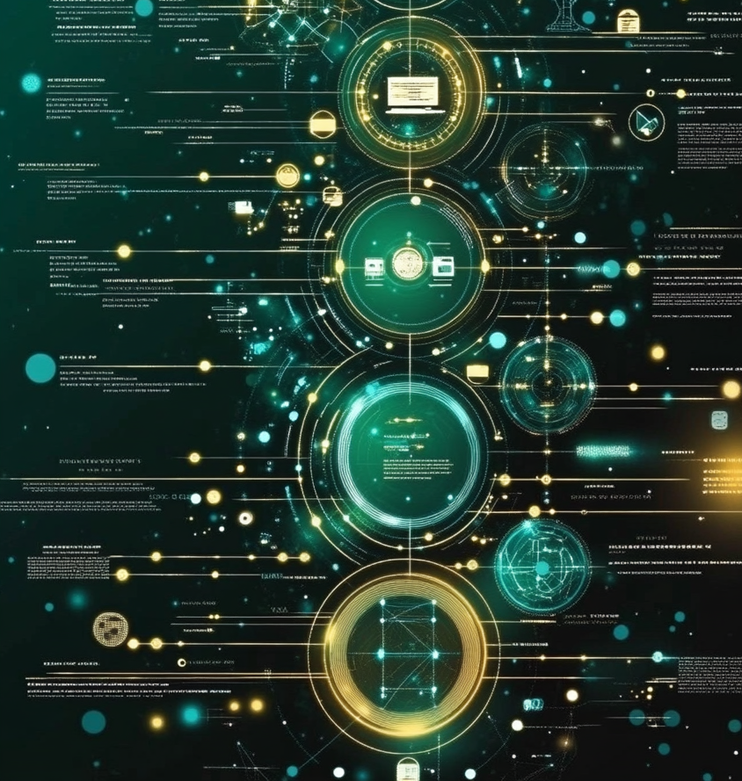
Introduction to
VISION, ADAPT, LEAP
The AI-XP Feedback Loops
- VISION : Increment
- ADAPT : Iterate
- LEAP : Execute
Justin Beall
/justin-beall
Notes:
**Summary:**
This slide introduces three essential feedback loops—VISION, ADAPT, and LEAP—within AI-XP, defining their specific roles and timelines.
**Speaker Notes:**
Introduction to Frameworks:** The AI-XP Feedback Loops—VISION, ADAPT, LEAP—are crucial to integrating AI with XP methodologies."
- **VISION - Strategic Increment:** Describe VISION's role in long-term strategic planning, focusing on 1-3 month increments that align team objectives with market trends.
- **ADAPT - Agile Iteration:** Highlight ADAPT's function in ensuring agile responsiveness over 1-3 week iteration cycles, allowing teams to pivot and adjust plans based on real-time feedback.
- **LEAP - Daily Execution:** Explain LEAP's contribution to immediate execution needs, optimizing daily tasks and decision-making processes within seconds to days.
- **Collective Synergy:** "By working in harmony, these loops foster an adaptable and innovative development environment."
**Acronyms:**
- **AI-XP**: Artificially Intelligent eXtreme Programming
- **VISION**: Visionary Integration and Strategic Oversight Navigated by AI
- **ADAPT**: AI-Driven Agile Planning and Transitions
- **LEAP**: LLM Enhanced Agile Programming

Slide 11

Key Acronyms
AI-XP
Artificially Intelligent eXtreme Programming
VISION (1-3 Months)
Visionary Integration and Strategic
Oversight Navigated by AI
ADAPT (1-3 Weeks)
AI-Driven Agile Planning and Transitions
LEAP (Seconds to Days)
LLM Enhanced Agile Programming
AI-XP Unpacked
- https://tinyurl.com/ai-xp-unpacked
Justin Beall
/justin-beall
Notes:
**Summary:**
This slide references important acronyms unique to the AI-XP context, enhancing understanding and clarity.
This is one of the few heavy text slides
**Speaker Notes:**
- **Introduction to Acronyms:** "As we conclude, here's a roundup of the key acronyms central to our session, which define the AI-XP framework."
- **Acronym Definitions:**
- **AI-XP:** Artificially Intelligent eXtreme Programming
- **VISION:** Visionary Integration and Strategic Oversight Navigated by AI
- **ADAPT:** AI-Driven Agile Planning and Transitions
- **LEAP:** LLM Enhanced Agile Programming
- **Significance:** Highlight how these acronyms encapsulate critical concepts in integrating AI with agile practices, providing a concise language for discussing AI-enhanced methodologies.
- **Encouragement:** Encourage applying these frameworks in exploring AI solutions within agile workflows.

Slide 12
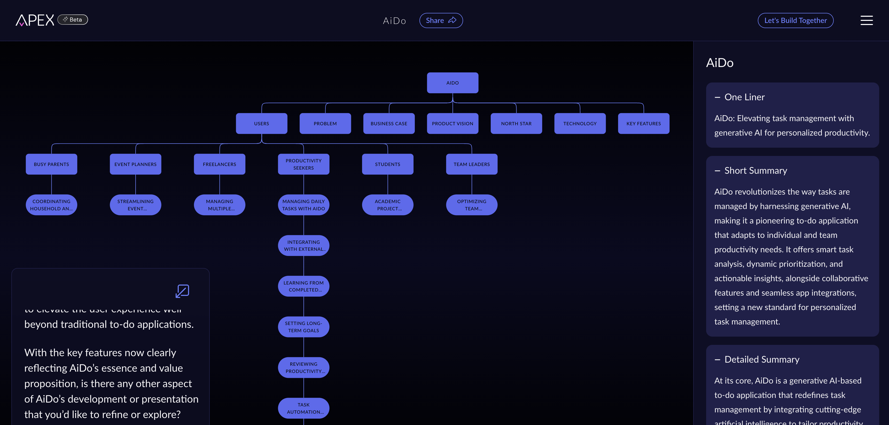
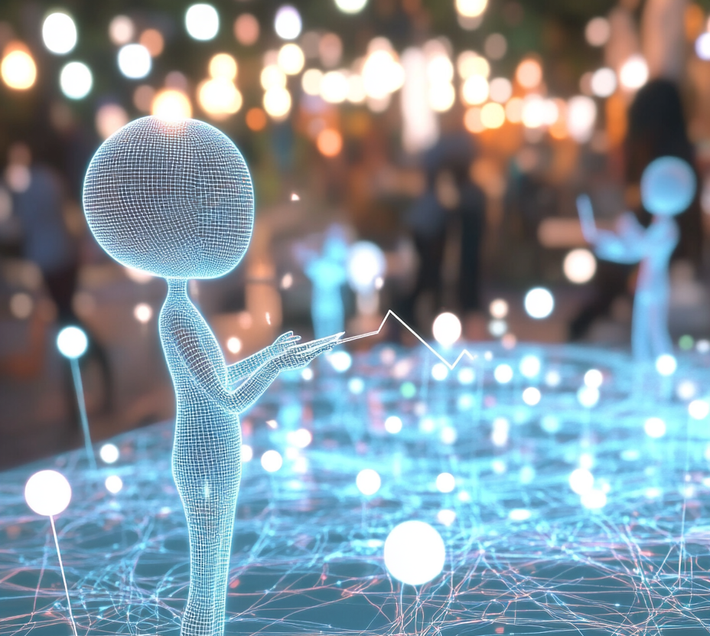
VISION with AiDo
VISION in Action
with APEX
- Strategic Product Definition
Made Accessible
APEX
- https://apex.artium.ai/
Rapidly Create a Product Definition with APEX
- https://youtu.be/DB-Bx424dJo
Justin Beall
/justin-beall
Notes:
**Summary:**
This slide highlights how AiDo, through the APEX product, applies the VISION framework to effectively enable strategic product definition and planning.
**Speaker Notes:**
- **Introduction to VISION in Action:** "Here’s how AiDo implements VISION, focusing on strategic product definition and planning with its APEX product."
- **APEX Features:** Highlight APEX’s capability to transform large datasets into strategic insights and its user-friendly interface that facilitates seamless strategic planning.
- **Efficiency and Cost-Effectiveness:** Explain how APEX offers high-level consultancy-like insights cost-effectively, broadening access to strategic planning tools.
- **Data Transformation:** Showcase how APEX efficiently translates raw data and customer feedback into actionable strategies.
- **Democratizing Strategy:** Emphasize how APEX empowers teams by making strategic planning accessible to organizations of all sizes.
- **Further Exploration:** "For more details, visit the AiDo APEX page - https://apex.artium.ai/products/53bda5df-b274-4572-bdab-9b155b4298ca."

Slide 13
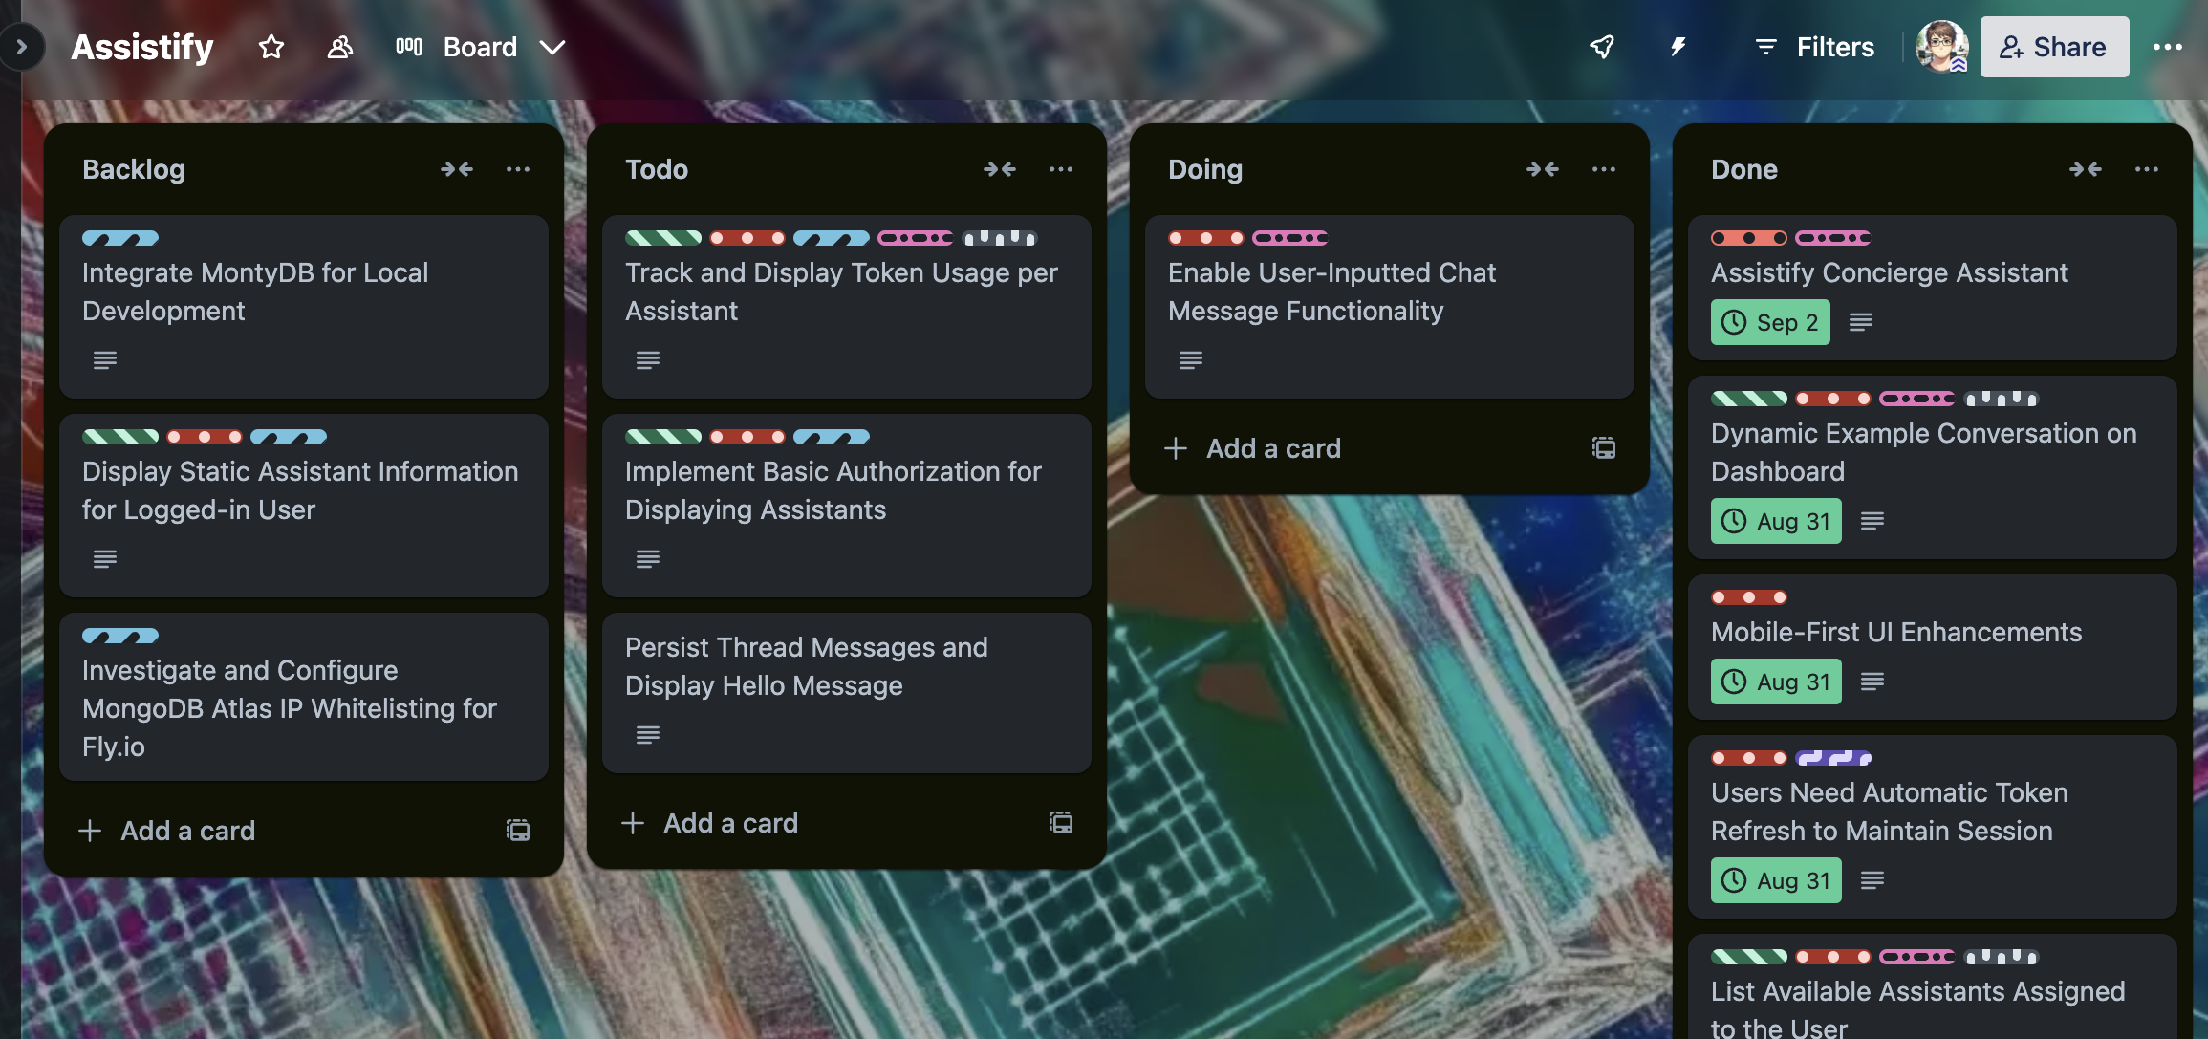

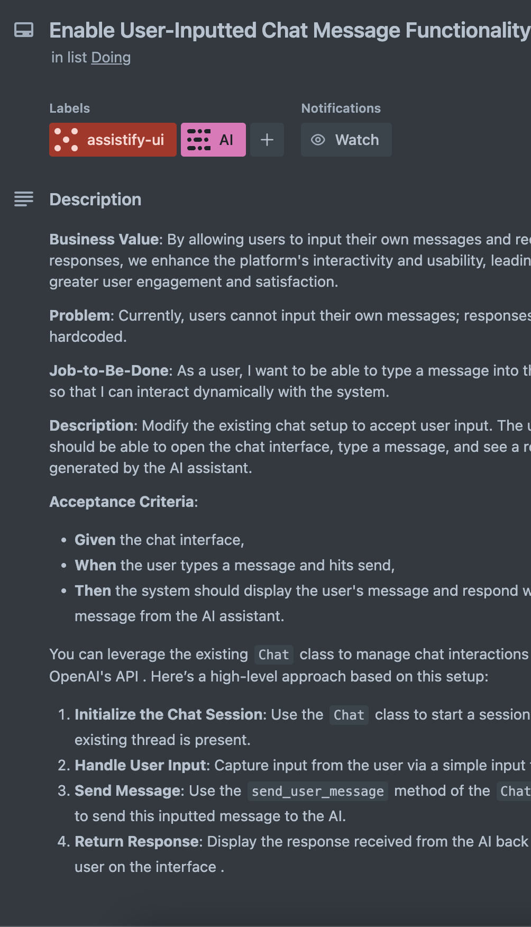
ADAPT with
Assistify
ADAPT in Action
Responsiveness in Development
Building a Virtual Product Owner with AI
- https://youtu.be/l4SL91Yx3RM
Justin Beall
/justin-beall
Notes:
**Summary:**
This slide showcases the application of the ADAPT framework in the Assistify project, highlighting AI's role in enhancing agile iteration through dynamic adjustments.
**Speaker Notes:**
- **Introduction to ADAPT with Assistify:** "This example illustrates how the ADAPT framework was applied using the Assistify Trello board and an AI-generated user story."
- **AI-Generated User Stories:** Discuss the role of AI in generating user stories that guide iteration planning and execution, serving as virtual assistants akin to a product owner.
- **Collaborative Virtual Assistants:** Emphasize how AI acts like a virtual product owner, managing and maintaining work items, and helping prioritize tasks within the Trello board.
Process Management Enhancements:** Highlight how these AI collaborations improved the management of agile processes, showcasing efficient collaboration and real-time iteration adjustments.
- **Example of Collaboration:** "An AI assistant effectively curated tasks, helping teams adapt rapidly based on fresh insights and shifting priorities."

Slide 14

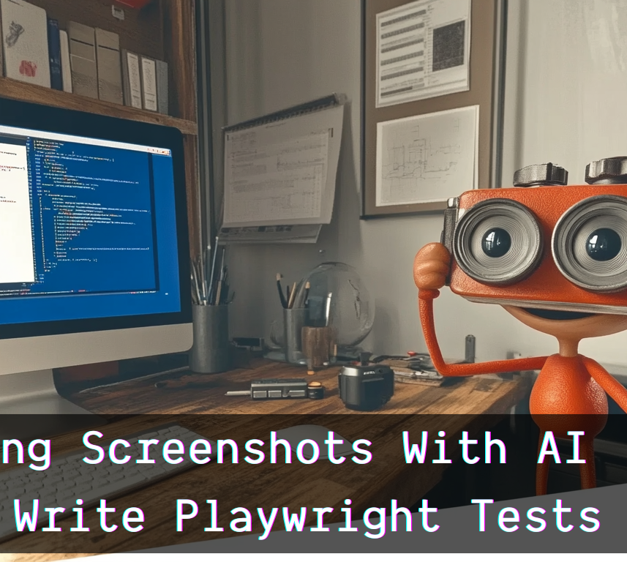
LEAP and
Playwright Tests
LEAP in Action
- Automating with AI in Testing
Building a Virtual Product Owner with AI
- https://youtu.be/l4SL91Yx3RM
Notes:
**Summary:**
This slide demonstrates the application of the LEAP framework through Playwright tests, showcasing AI's role in enhancing test automation for improved efficiency and precision.
**Speaker Notes:**
- **Introduction to LEAP with Playwright Tests:** "Here's an example of how the LEAP framework applies to automating tests using Playwright."
- **AI-Driven Test Automation:** Highlight how AI assists in automating routine testing tasks, enhancing execution speed and accuracy with tools like Playwright.
- **Efficiency Gains:** Discuss specific examples in which AI-led test automation resulted in significant time savings and error reduction, allowing developers to focus on more complex and creative tasks.
**Collaborative AI-Human Execution:** Emphasize the synergy between AI automation and human oversight, where AI handles repetitive tasks, and humans guide strategic decision-making in testing.

Slide 15

Redefined Concepts
Evolving Development Concepts
- Content : Outputs
- Process : Workflows
- Product : Features and UX
Justin Beall
/justin-beall
Notes:
**Summary:**
This slide explains how AI is transforming traditional development concepts, particularly those related to content, process, and product, by redefining them through an AI lens.
**Speaker Notes:**
- **Introduction to Redefined Concepts:** "As AI becomes more integrated, we're seeing a redefinition of fundamental development concepts—content, process, and product—which are now heavily influenced by AI capabilities."
- **Content as AI-Generated Outputs:** Discuss how AI increasingly generates content, from documentation and code to entire solutions, enhancing efficiency and creativity.
- **AI-Augmented Processes:** Highlight how traditional workflows are being augmented by AI, leading to improved efficiency, reduced errors, and faster iterations through intelligent tools and recommendations.
- **AI-Enhanced Products:** Explain how AI empowers the creation of more innovative products with enhanced features and improved user experiences, guided by AI insights and continuous improvements.
- **Alignment to Needs:** Stress how these transformations better align developments with evolving customer expectations and business goals.

Slide 16

Intersecting
Frameworks
Increment: Strategic Vision
Aligns long-term content planning,
process structure, and overarching
product direction
Iteration: Agile Adaptation
Supports flexibility in content
creation, process adjustments,
and ongoing product enhancements
Execution: Immediate Implementation
Focuses on real-time content updates,
process efficiencies, and instant
product features
Justin Beall
/justin-beall
Notes:
**Summary:**
This slide underscores the importance of understanding the intersection between development aspects—content, process, and product—and the phases of increment, iteration, and execution.
**Speaker Notes:**
- **Introduction to Intersecting Frameworks:** "To fully integrate AI in agile practices, it's vital to align three core elements—content, process, and product—with the phases of increment, iteration, and execution."
- **Framework Overview:** Explain how **Increment** relates to long-term content goals, strategic process planning, and high-level product vision.
- **Iteration Focus:** Highlight the agile iteration phase, emphasizing adaptable content generation, dynamic process adjustments, and frequent product updates.
- **Execution Detail:** Describe the daily execution phase where real-time content modifications, immediate process implementations, and day-to-day product enhancements occur.
- **Comprehensive Understanding:** Encourage teams to maintain this intersectional perspective to ensure cohesive and holistic development efforts.

Slide 17
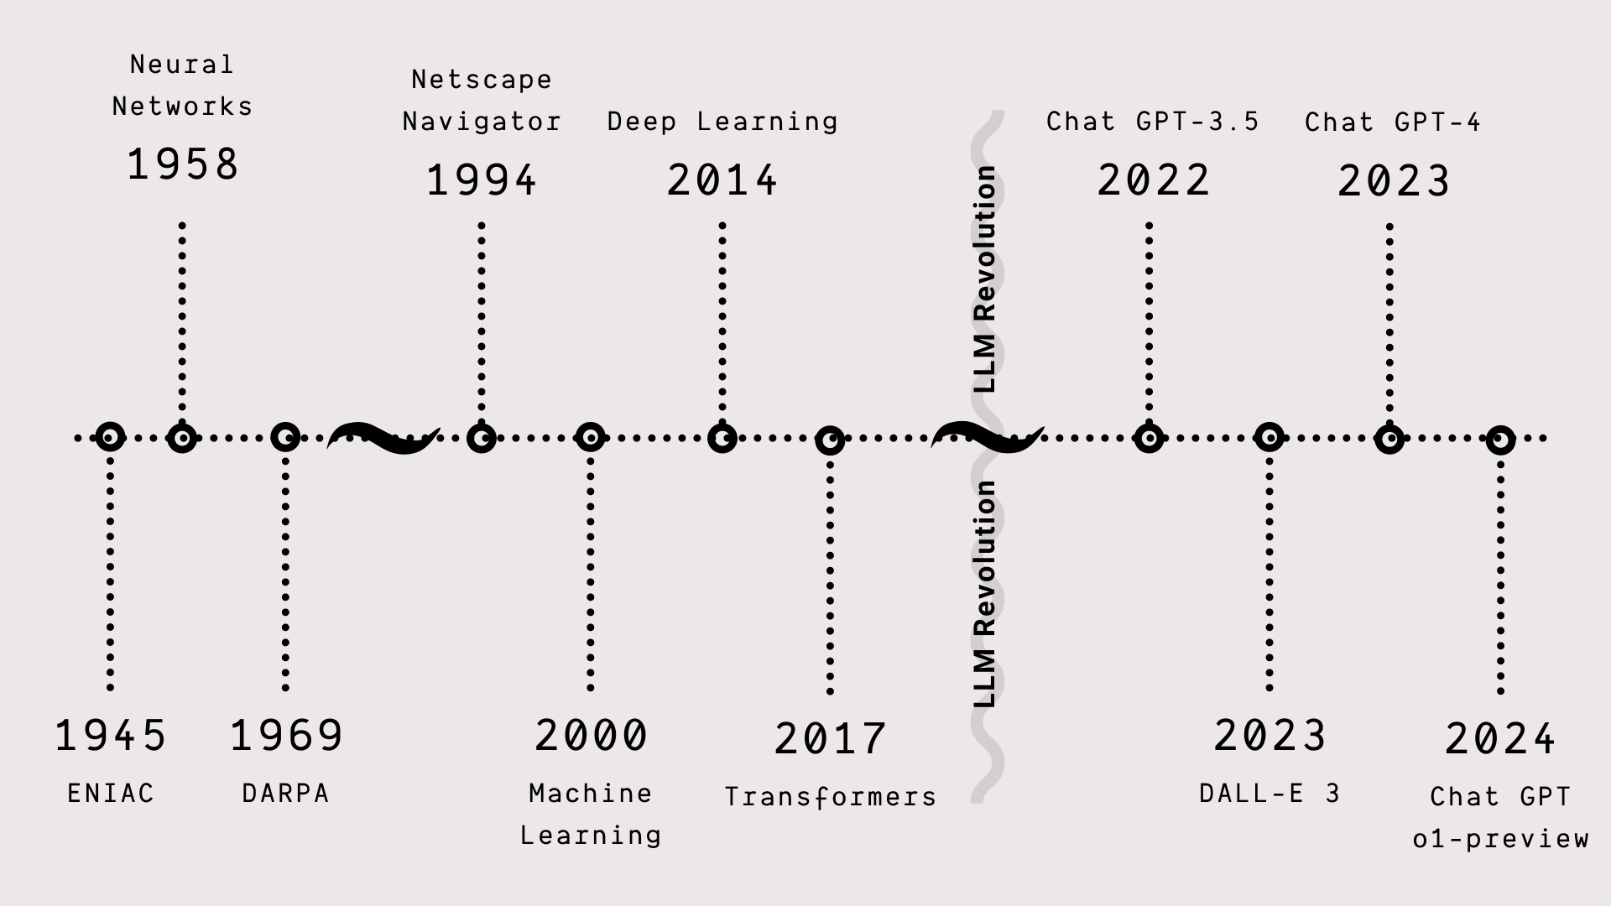

AI Timeline
- Machine Learning
- Neural Networks
- Large Language Models
Notes:
**Summary:**
This slide provides a timeline exploration of AI's evolution, illustrating the spectrum of AI technologies from foundational developments to modern large language models (LLMs).
**Speaker Notes:**
- **AI Evolution Overview:** "This slide outlines the historical progression and expansion of AI technologies over several decades."
- **Historical Context:**
- 1940s-1950s: Birth of Modern Computers
- 1960s: Initial Concepts of Neural Networks (Binary Layers)
- 1969: Development of the DARPA Internet
- 1990s: Emergence of the Internet Which Set the Stage for AI
- Late 1990s - Early 2000s: Basic Machine Learning
- 2010s: Revolution in Deep Learning Techniques
- 2017: Google’s Transformer Paper ("Attention is All You Need")
- 2022: Introduction of ChatGPT and Start of the LLM Era
- **Technology Intersection:** Discuss how these points serve as milestones, connecting traditional methods with transformative AI breakthroughs.
- **Future Perspective:** Highlight the potential future developments spurred by the current state of AI technology and its application in various sectors.

Slide 18

Machine Learning
as a Product
Tangible Business Insights
Campaign Effectiveness
Predictive analytics provide actionable
insights for marketing strategies
Ad Selection and Targeting
Dynamic audience segmentation and
personalized content delivery
User Retention and Stickiness
Leveraging ML to understand user behaviors
Justin Beall
/justin-beall
Notes:
**Summary:**
This slide emphasizes the role of machine learning in enhancing products, focusing on campaign effectiveness, ad targeting, and creating addictive applications that boost user retention.
**Speaker Notes:**
- **Introduction to ML-Enhanced Products:** "Machine learning significantly enhances product offerings by providing valuable insights and boosting user engagement."
- **Campaign Effectiveness:** Discuss how predictive analytics driven by machine learning offer actionable insights, allowing for more effective marketing strategies that respond dynamically to consumer behaviors.
- **Ad Selection and Targeting:** Explain the role of ML in enabling real-time audience segmentation and personalized ad delivery, optimizing engagement rates and conversion outcomes.
- **User Retention and Stickiness:** Highlight how machine learning contributes to app stickiness by understanding and predicting user behaviors, preferences, and needs. Thus, it fosters continuous engagement and creates the highly engaging, addictive apps common today.
- **Business Impacts:** underscoring how these capabilities integrate into broader product strategies, driving market differentiation and sustained user interest.

Slide 19
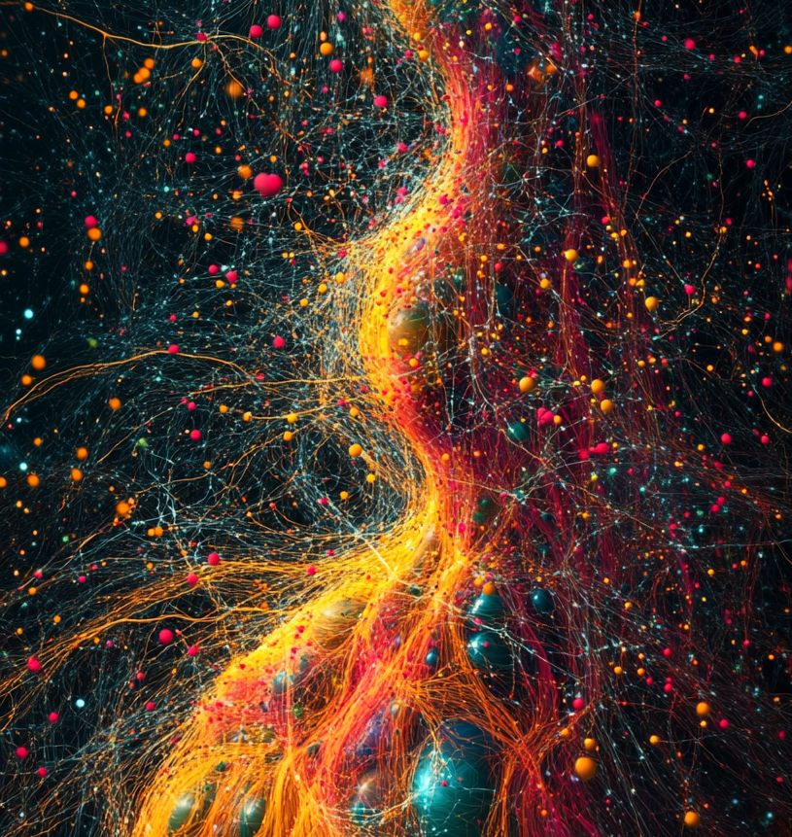
Neural Networks
Explained
Neural Networks:
The Pattern Specialists
- Pattern Recognition
- Decision-Making Processes
- Deep Learning
Examples
- Image Recognition
- Voice Recognition
- Fraud Detection
Justin Beall
/justin-beall
Notes:
**Summary:**
This slide dives into neural networks’ fundamental architecture and showcases their diverse applications in recognizing patterns and facilitating decision-making.
**Speaker Notes:**
- **Introduction to Neural Networks:** "At the core of AI capabilities, neural networks specialize in recognizing complex patterns and aiding decision processes."
- **Three-Layer Network Example:** Describe a typical neural network structure:
- **Input Layer:** Where raw data inputs first enter the network.
- **Computational Layer (Hidden Layer):** Neurons process these inputs, performing necessary computations to identify patterns and connections.
- **Output Layer:** Outputs provide the network’s results after processing.
- **Examples of Neural Network Applications:**
- **Image Recognition:** Used in developing features like facial recognition systems or autonomous vehicles, identifying objects or faces in images.
- **Voice Recognition:** Facilitates personal assistants like Siri or Alexa, interpreting spoken instructions accurately.
**Fraud Detection:** This term is used in financial sectors to analyze transactions to detect and prevent fraudulent activities.
- **Innovative Capacity:** Discuss how increasing data volumes and advanced architectures enable neural networks to tackle more complex tasks, continuing to evolve in capability and application.

Slide 20

Generative AI
The Expanding Universe
of Generative AI
- Text Generation
- Image Creation
- 30-Second Videos
- Whole Songs & Voice Cloning
- Synthetic Data Generation
Justin Beall
/justin-beall
Notes:
**Speaker Notes:**
- **Introduction to Generative AI Capabilities:** "Generative AI encompasses a wide spectrum of abilities, extending beyond text to enrich various creative and functional domains."
- **Key Capabilities:**
- **Text Generation:** Discuss traditional uses of AI in generating written content.
- **Image Creation:** Highlight AI's capacity to create high-quality images for art, media, and advertising applications.
- **30-Second Videos:** Explain AI's role in producing short video content that enhances marketing strategies and audience engagement.
- **Whole Songs & Voice Cloning:** Describe how AI technologies facilitate the creation of entire songs and realistic voice simulations, opening new possibilities in entertainment and personalized experiences.
- **Synthetic Data Generation:** Emphasize the generation of artificial datasets to train AI models, providing a valuable tool for research without relying heavily on real-world data.
- **Implications and Opportunities:** Reflect on how these advancements impact fields such as marketing, education, and virtual reality, underscoring the integral role of generative AI in technological innovation.

Slide 21

Personal Reflection
and Insights
Navigating the AI Landscape
- What Services or Tools Meet Your Needs?
- Custom Solutions: Worth the Effort?
- Time Investment: Prompts vs. Set-Ups
Justin Beall
/justin-beall
Notes:
**Summary:**
This slide encourages a reflective exploration of tools and strategies for integrating AI and evaluating their suitability and effectiveness for your needs.
**Speaker Notes:**
- **Navigating the AI Marketplace:** "Discovering the right AI tools and services to meet your needs is crucial. Popular platforms like Descript can offer significant time and efficiency savings in areas like video editing."
- **Custom Solutions Consideration:** Address the factors involved in building custom AI solutions for specific use cases, weighing the costs and benefits compared to existing platforms.
- **Prompts vs. Set-Ups:** Highlight personal experiences showing that crafting effective prompts often requires more strategic thought than technical setups, yet they're vital for maximizing AI utility.
- **Balance and Outcomes:** Stress the importance of balancing these considerations with potential productivity, creativity, and innovation gains, advocating thoughtful planning and execution.

